Slide 1
DISEASE PREDICTION system USING SYMPTOMS

Slide 2
PROBLEM STATEMENT
1) Current situation in the healthcare industry
2) The correct prediction of disease is the most challenging task.
3) With the help of disease data, data mining finds hidden pattern information in the huge amount of medical data.
4) This project is based on disease prediction according to the symptoms shown by the patient

Slide 3
Working
Objective
Collecting Data
Preparing Data
Training and Evaluating Model

Slide 4
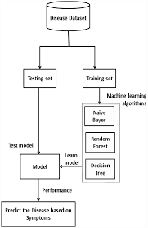
Block diagram

Slide 5
Algorithms used
There are four different kind of models present in our project to predict the disease these are
Decision tree
Random forest tree
Gaussian Naïve Bayes
KNN

Slide 6
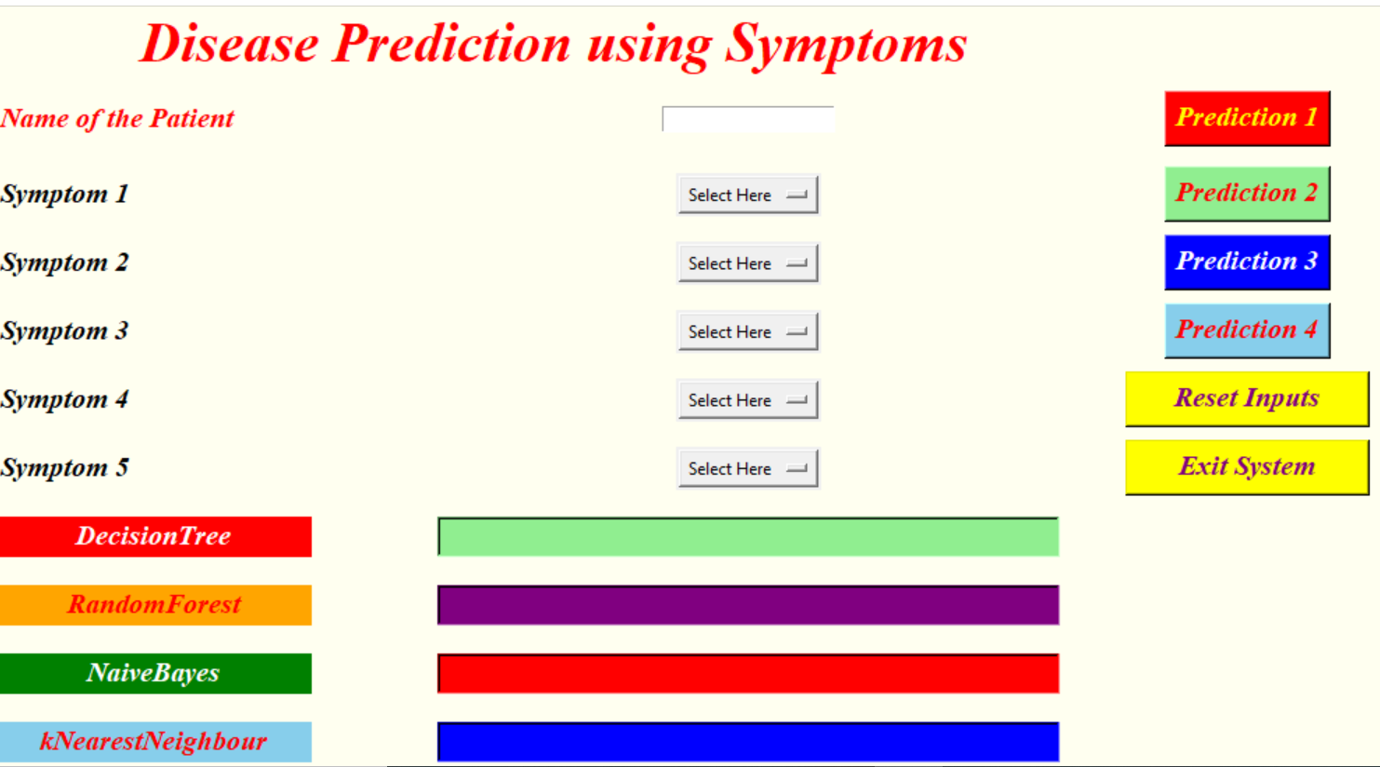
output

Slide 7
APPLICATIONS
Helpful for people living in rural or remote areas away from hospital and medical aid to diagnose a disease.
As disease detection is a hypercritical task, it will help doctors to easily predict a disease.
It will be an online help and support for the users to easily and smartly predict their health.
It is an automated program which is cost effective and saves huge time.

Slide 8
conclusion
We set out to create a system which can predict disease on the basis of symptoms given to it.
Such a system can decrease the rush at OPDs of hospitals and reduce the workload on medical staff.
We were successful in creating such a system and use 4 different algorithm to do so.
Creating this system we can also add a way to store the data entered by the user in the database which can be used in future to help in creating better version of such system. Our system also has an easy to use interface

Slide 9
THANK YOU

